Slide 1
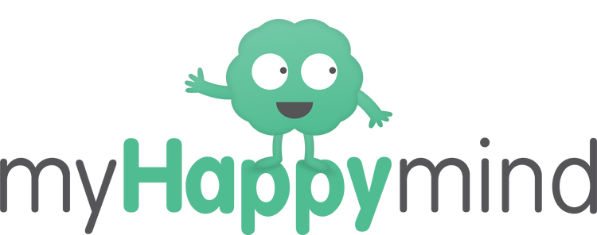



Impact Report
Sheet Primary School

Slide 2
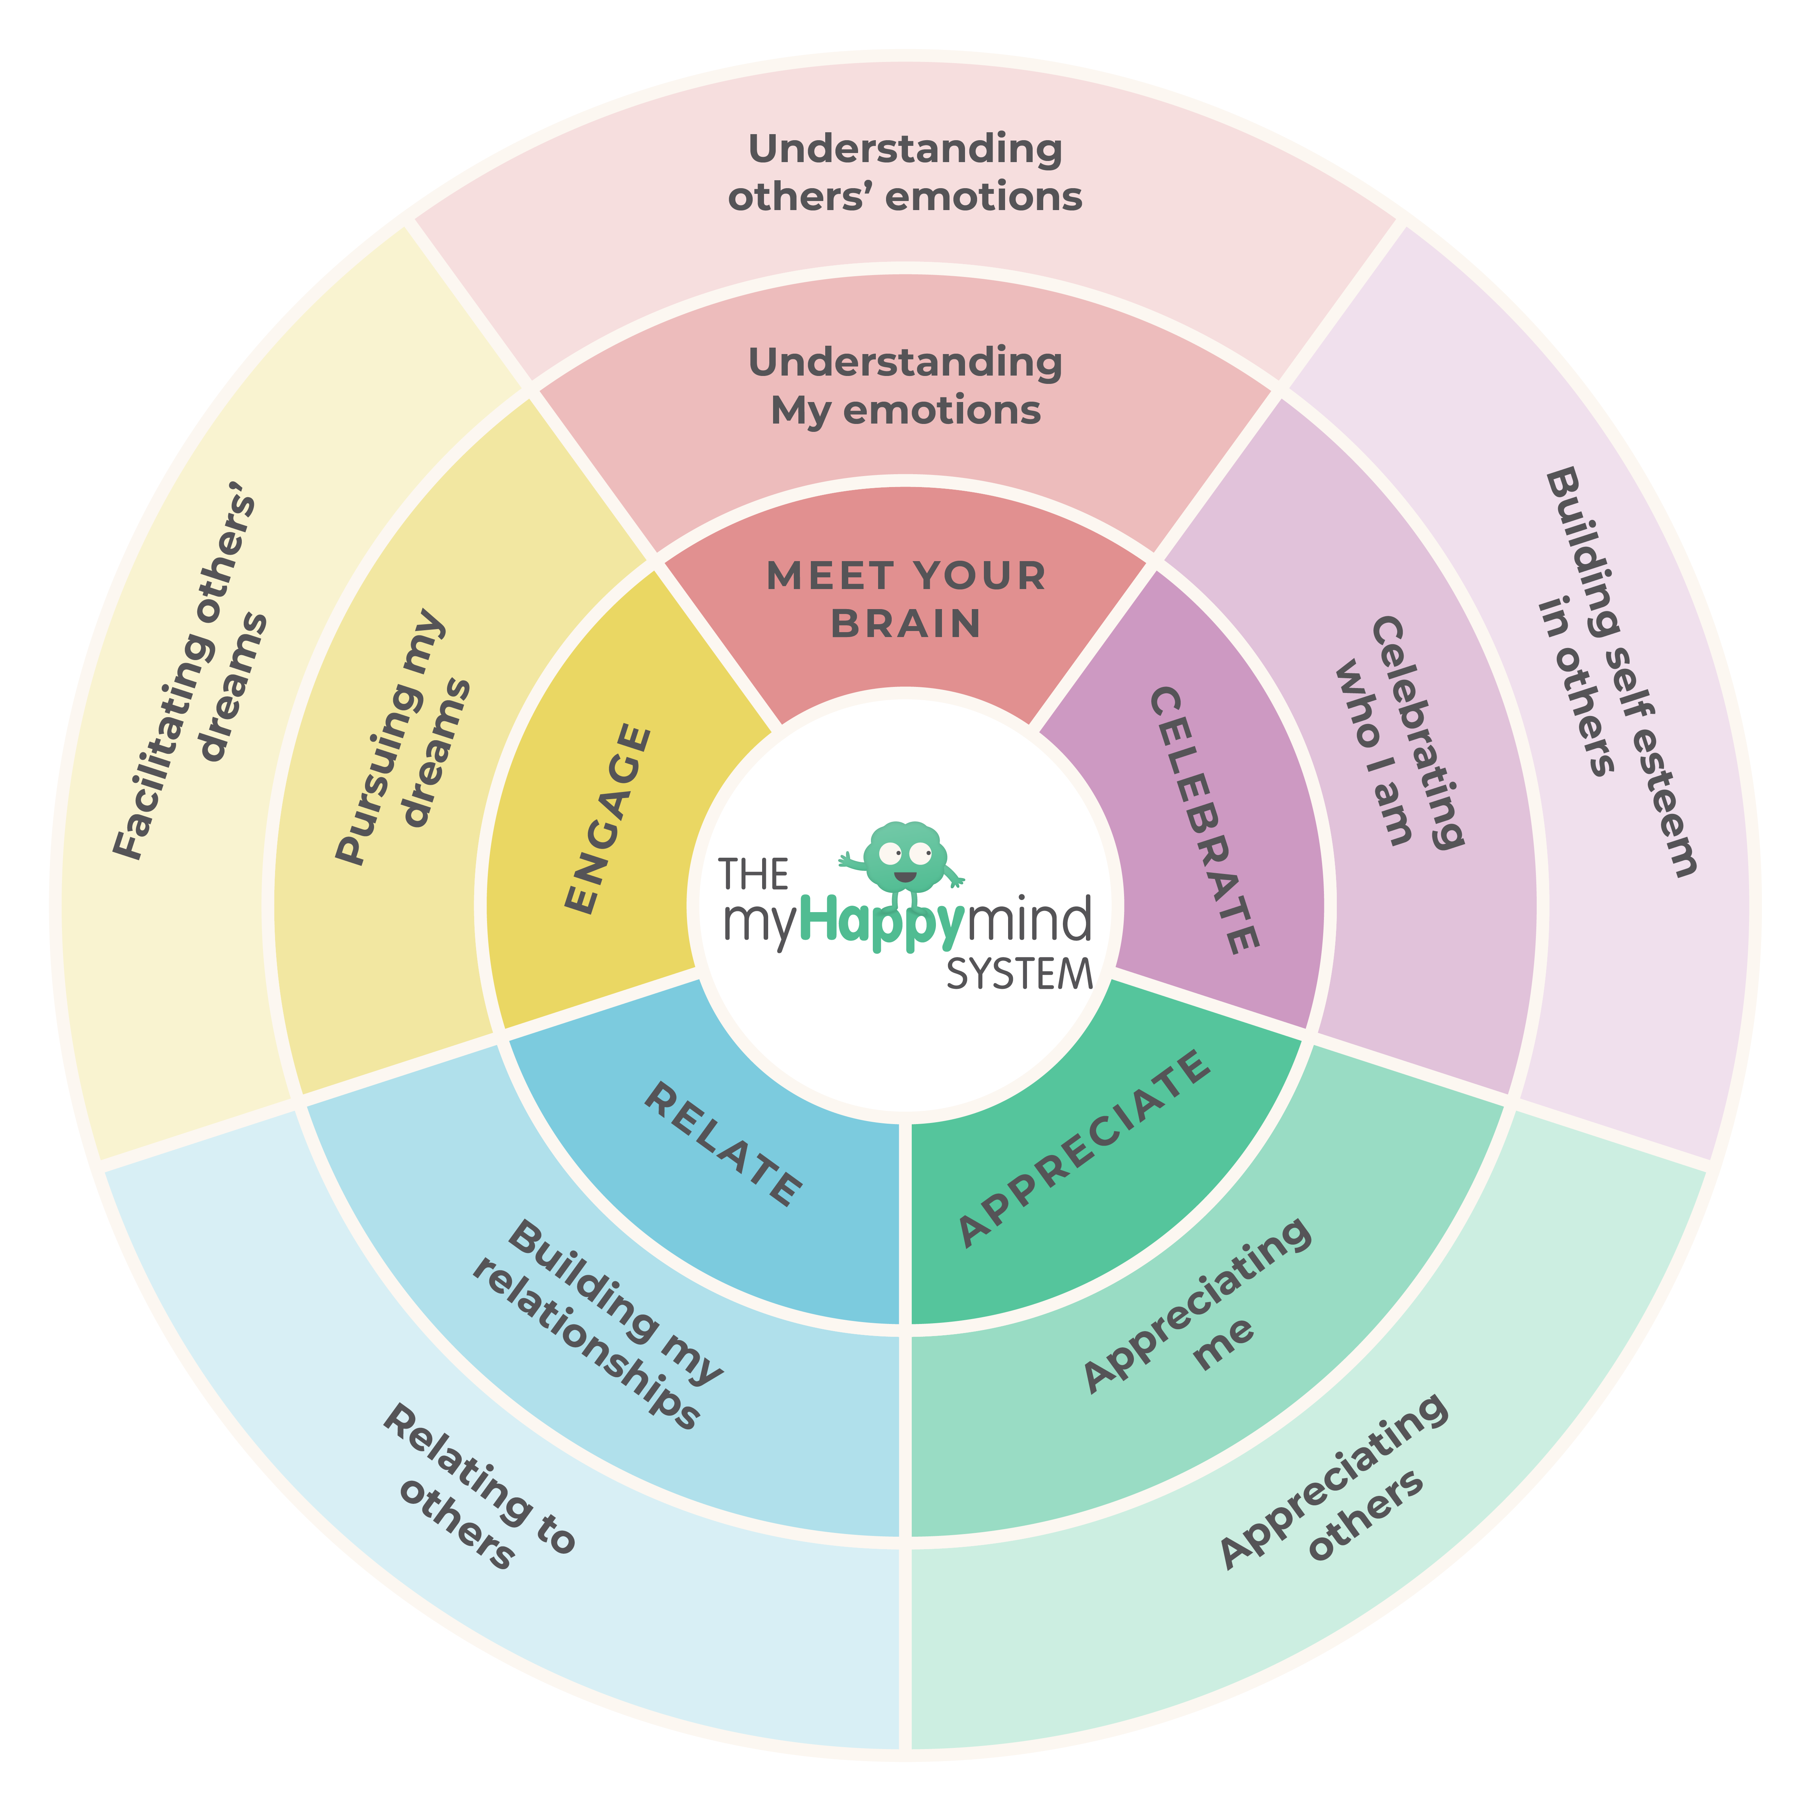
Impact Data
This report summarises the impact seen from myHappymind across the academic year. It is structured around your baseline data and the myHappymind system which is the content we teach in the programme.

Slide 3
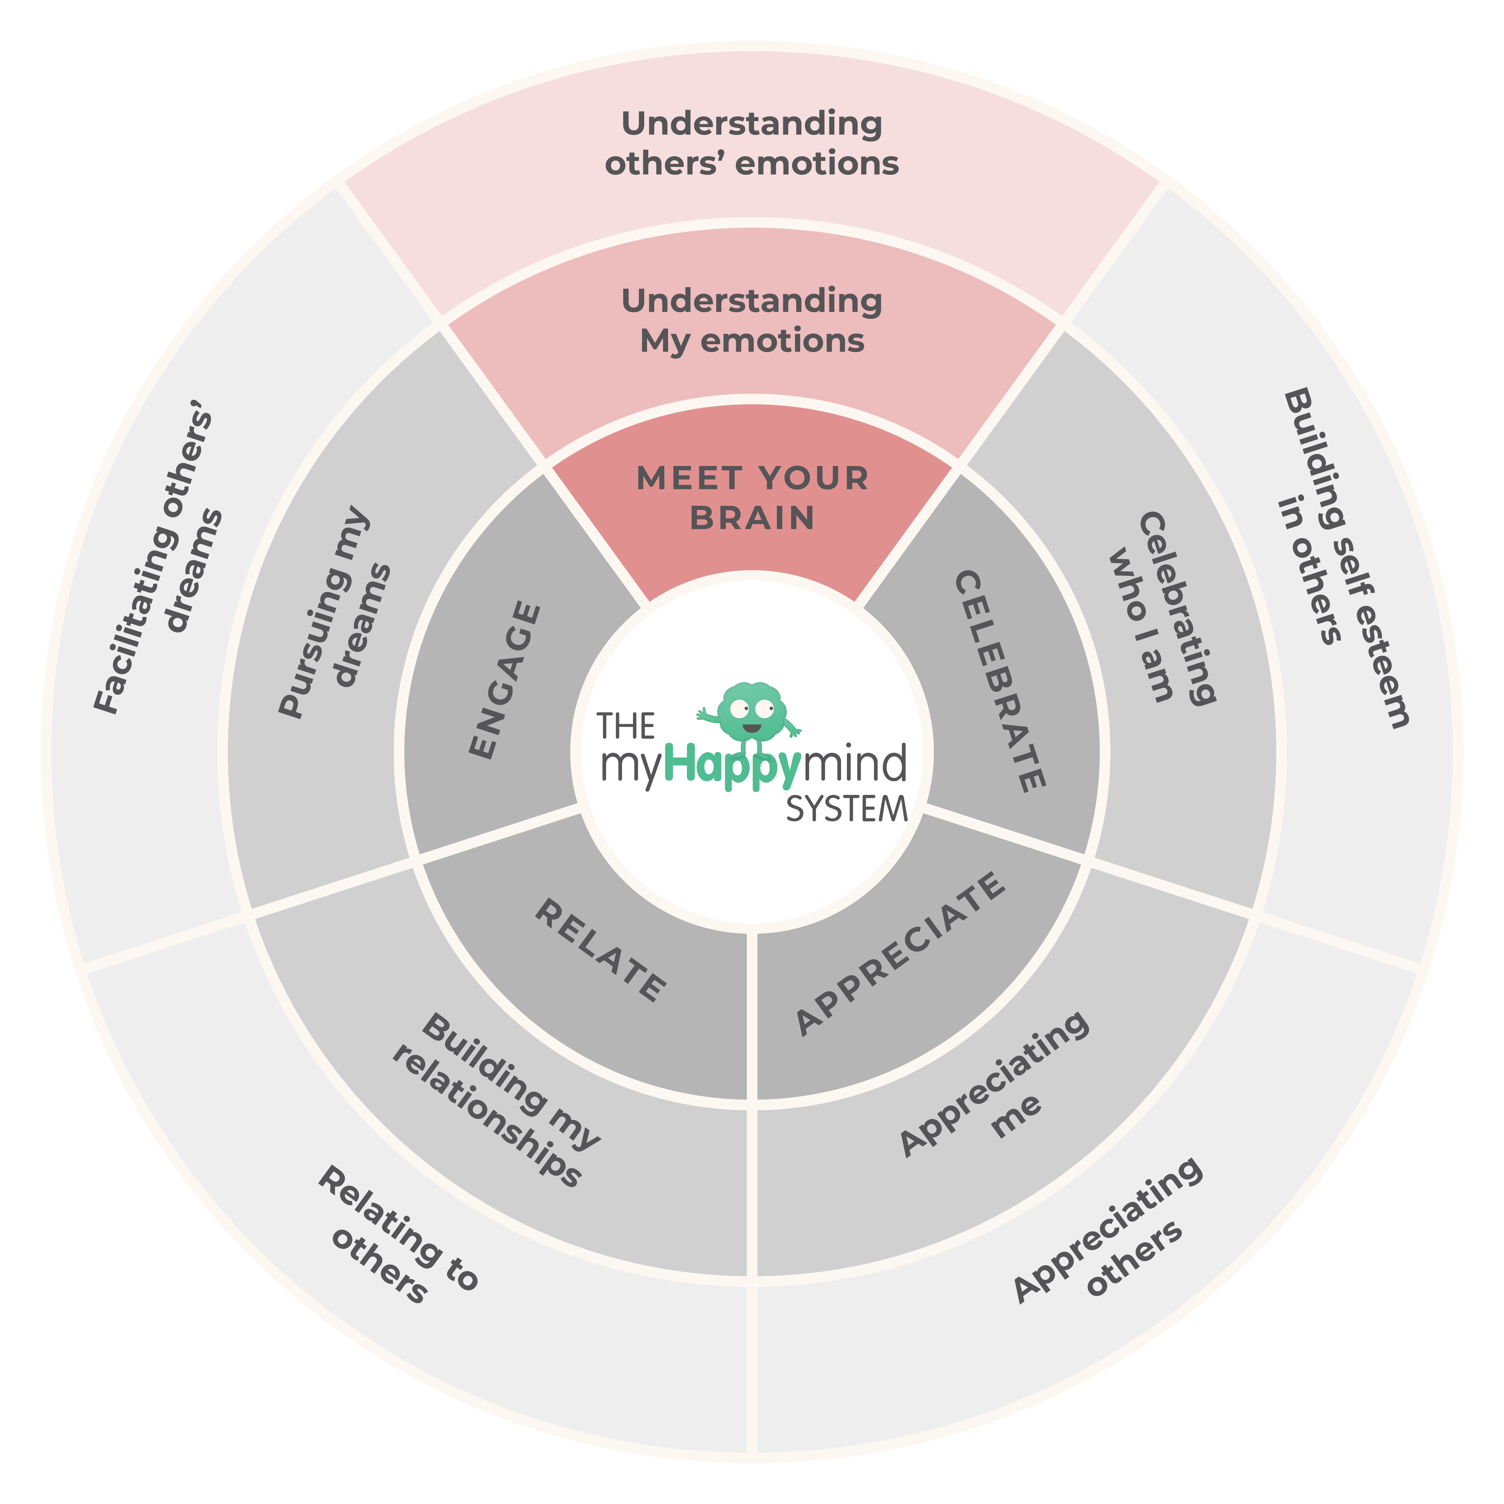
Meet Your Brain – Developing self regulation tools
In this module the children learn all about their brain and how it helps them to be
their best selves.
They develop self regulation strategies and a solid understanding of the Neuroscience of how we learn and grow. Understanding the brain is a key way to help children deepen their understanding of emotions and normalise the need to self regulate - a key strategy in building confidence and self esteem.

Slide 4
What teachers said before and after myHappymind
100%
of teachers said half or less of their children were aware of the factors that contribute to their wellbeing.
100%
of teachers have said this module has helped their class to understand their brain.
57%
of staff said half or less of their children have a method to self-regulate during times of stress and worry.
100%
of teachers have said Happy Breathing has benefitted their class.
86%
of staff said they do not spend more than one formal lesson per week learning about children’s emotional and mental health.
100%
of staff are now having 1-3 conversations (formal or informal) about children’s mental well-being each week.

Slide 5
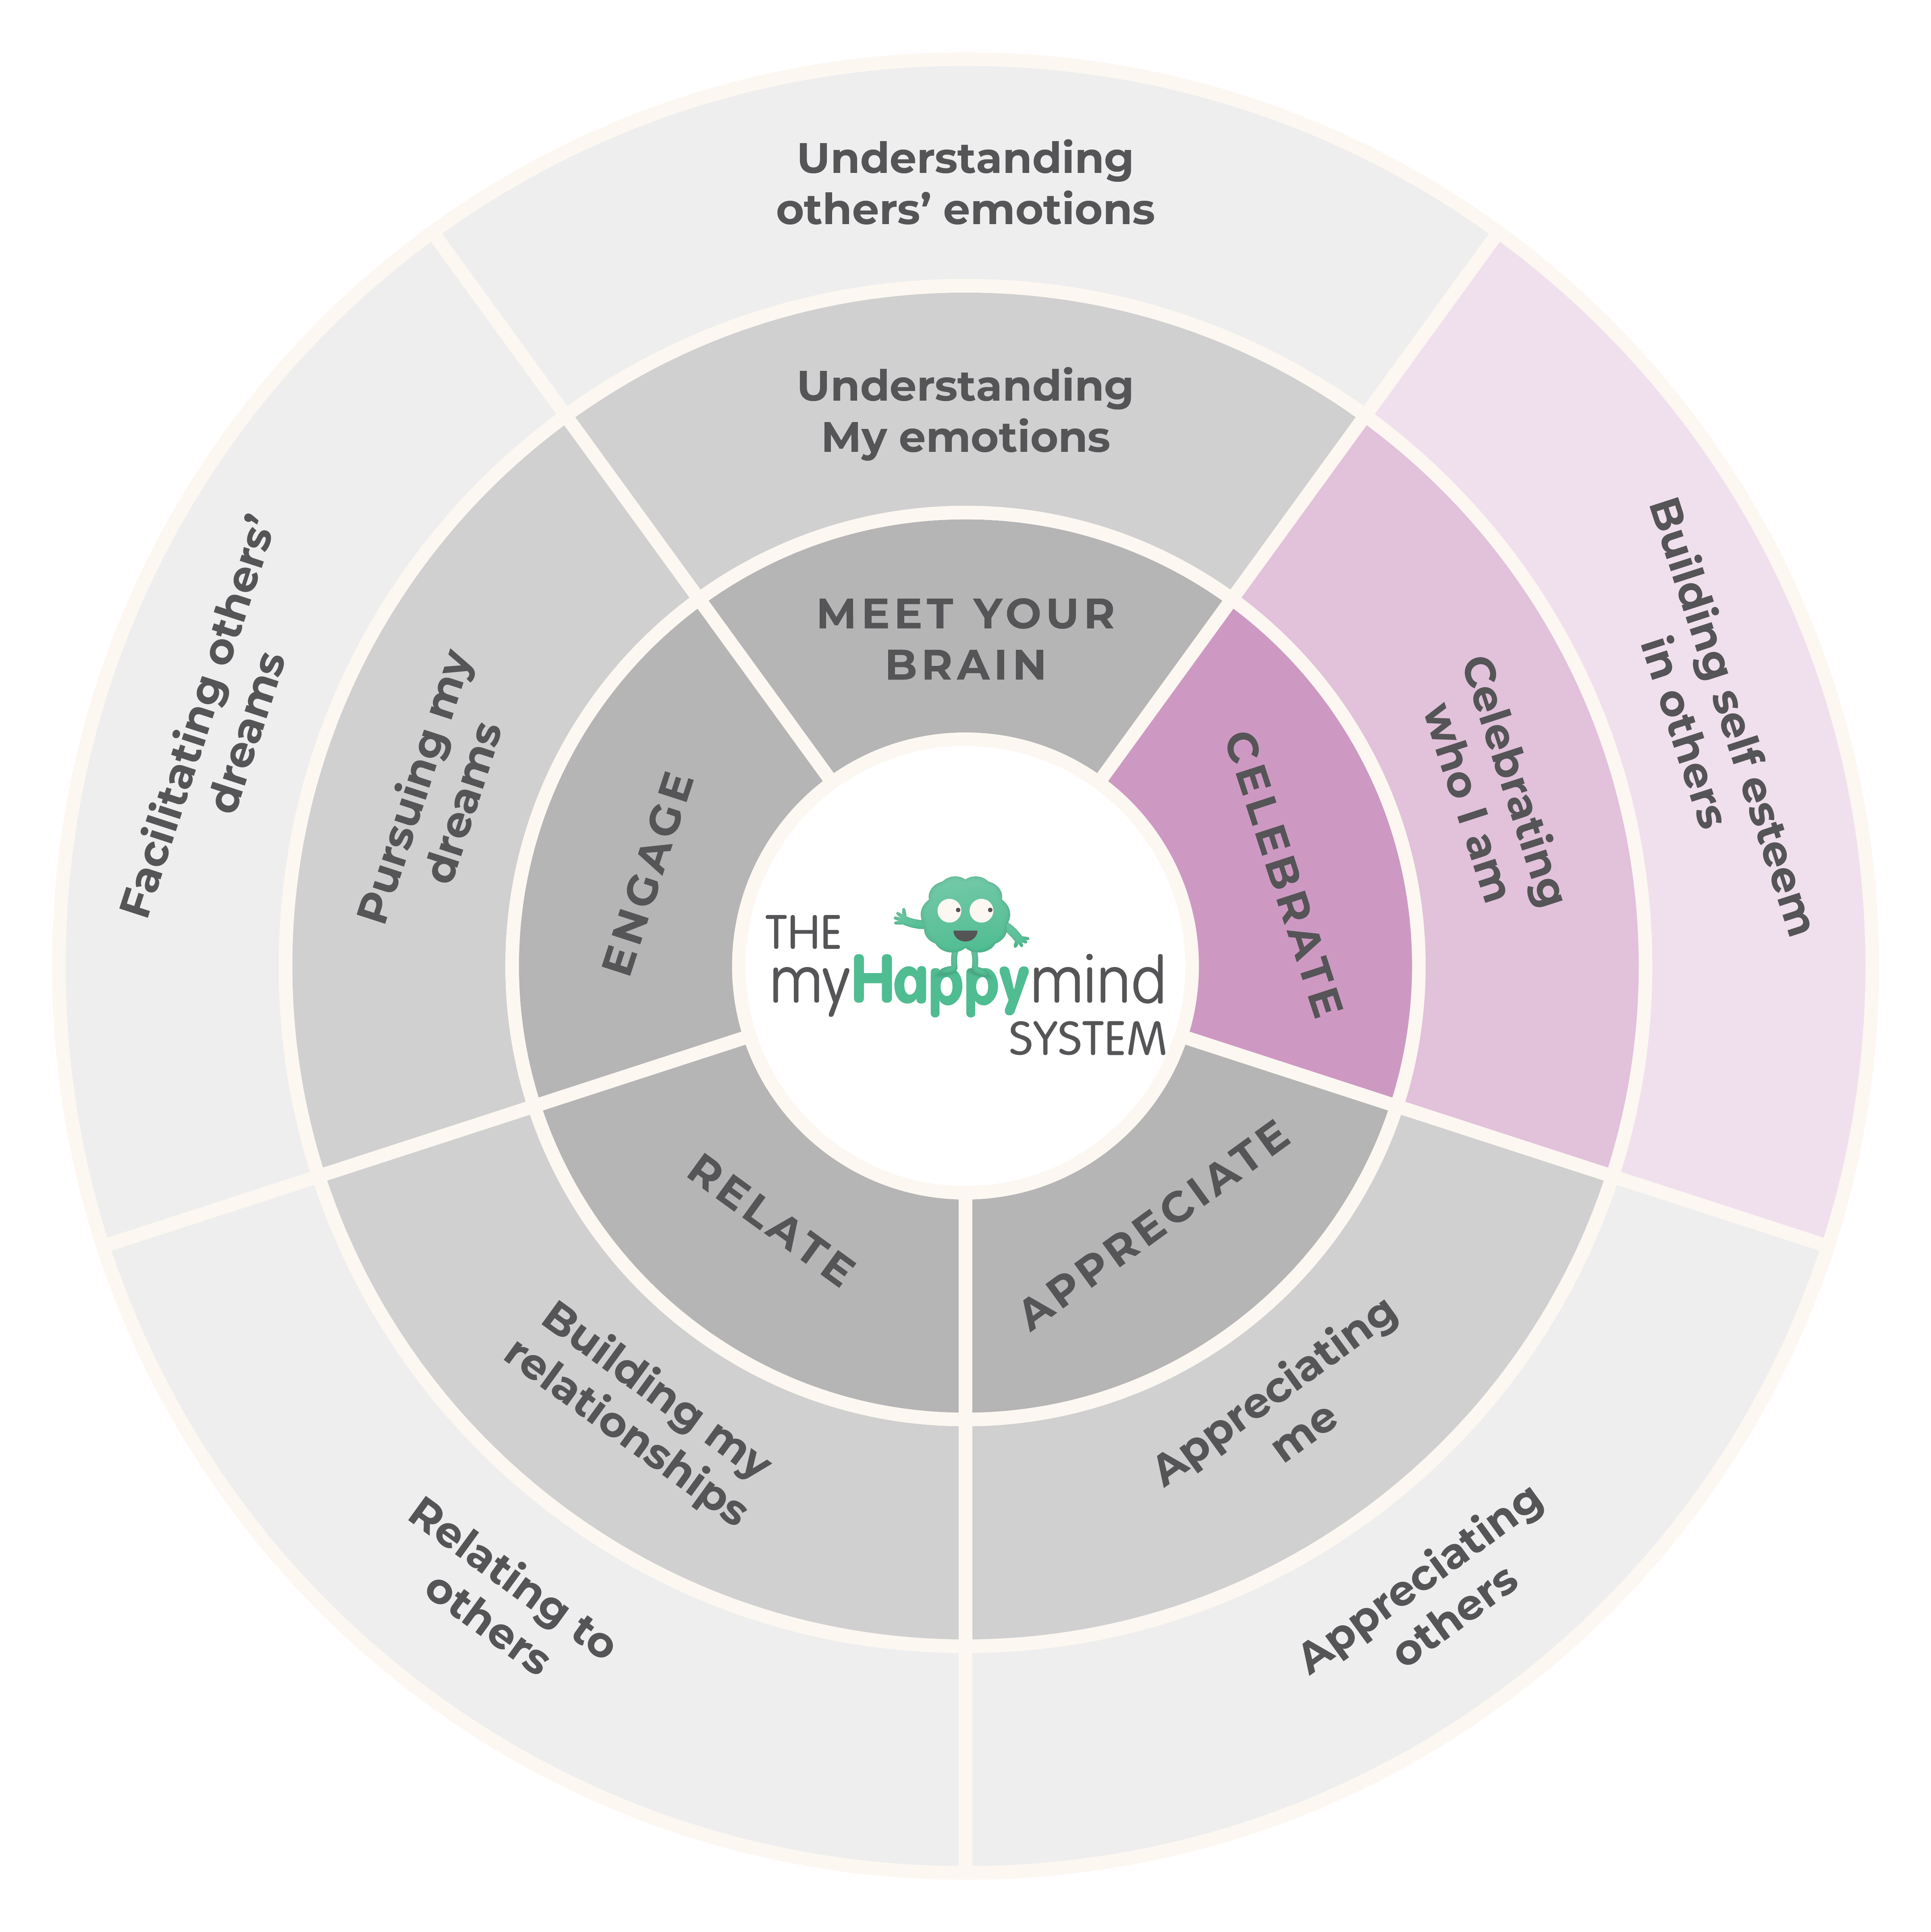
Celebrate –
Discovering and celebrating
Character Strengths
In this module the children learn all about their unique Character Strengths and develop strategies to celebrate them.
Character Strengths are the number one way to build self esteem and confidence in children and this module is all about developing the children’s self awareness and confidence.

Slide 6

What teachers said before and after myHappymind
71%
of teachers said half or less of their children can talk about their Character Strengths.
100%
of teachers said that their class are now able to talk about their Character Strengths.
57%
of teachers said at least half of their class struggle with their confidence.
75%
of teachers said that they have seen the self-esteem and confidence of their children improve from using myHappymind so far.
43%
of teachers said they do not notice or Celebrate character on a daily basis.
100%
of teachers said they are now using character-based praise through their regular teaching.

Slide 7
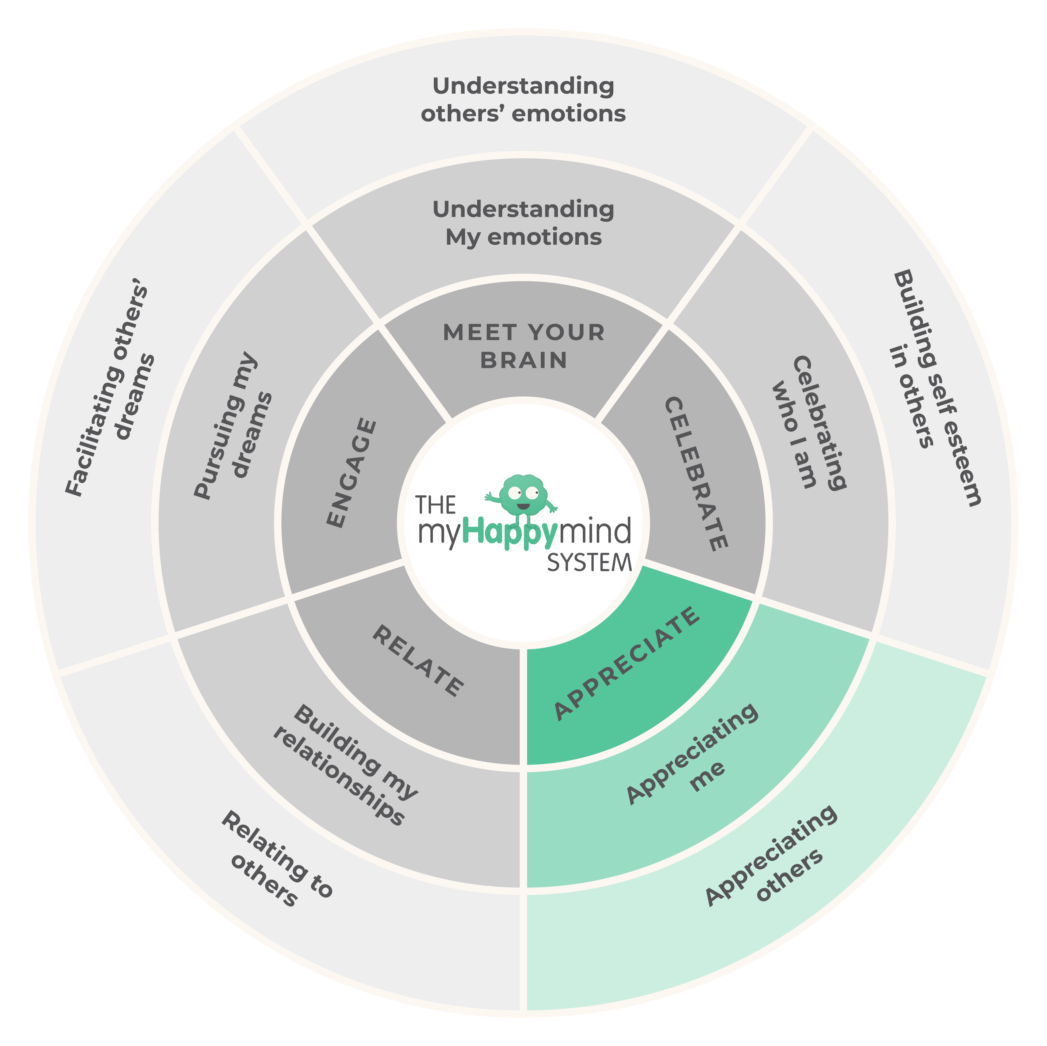
Appreciate - Developing an Attitude of Gratitude
In this module the focus is on helping children to develop an Attitude of Gratitude.
Gratitude is one of the simplest, yet most powerful ways to boost wellbeing in the short term and to create a healthy brain in the long term. By getting children used to expressing gratitude regularly we’re getting that dopamine flowing in the brain and supporting their overall happiness.

Slide 8
What teachers said before and after myHappymind
71%
of teachers said they do not notice children expressing Gratitude to each other or for experiences on a daily basis.
75%
of teachers said they are noticing more gratitude being shared in their classrooms.
100%
of teachers said at least half of their class would focus on gratitude for stuff if asked.
100%
of teachers said they have seen children expressing gratitude for people around them and experiences..
57%
of teachers said that their children do not proactively express Gratitude.
75%
of teachers said they have introduced an attitude of gratitude into their classroom.

Slide 9
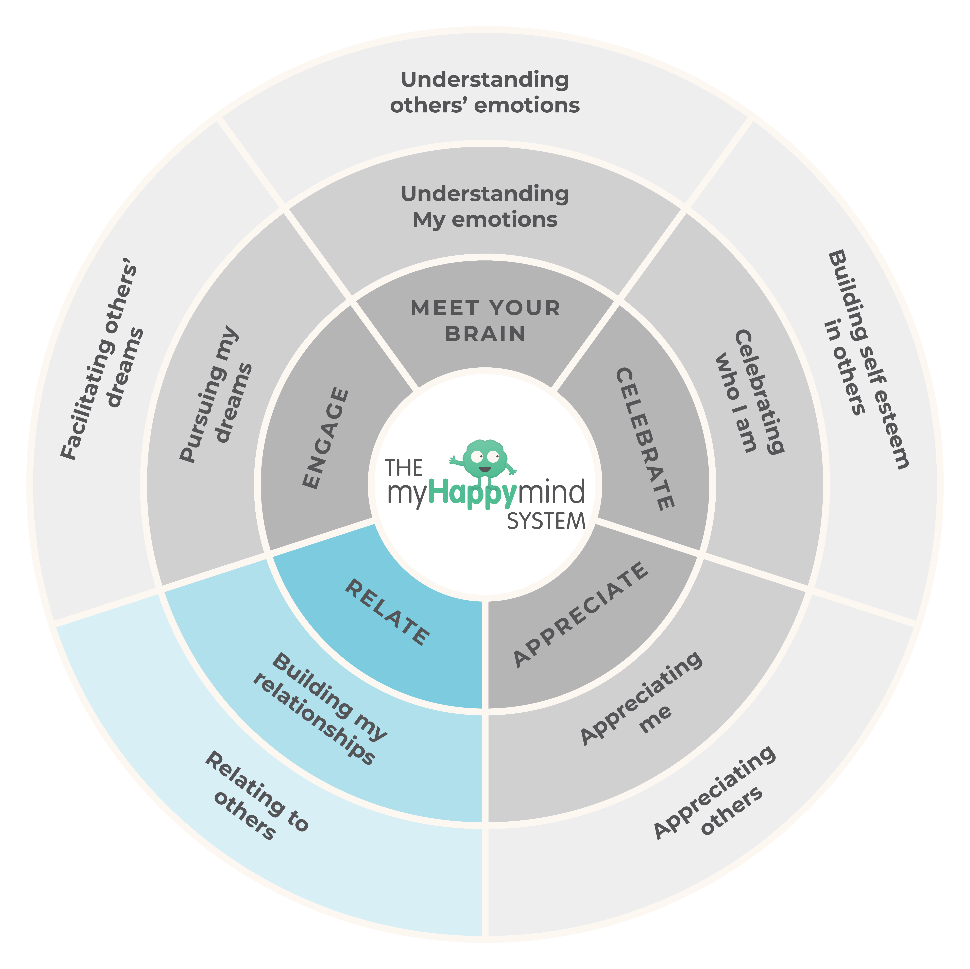
Relate -
Developing healthy relationships
In this module the children focus on developing healthy relationship habits.
This includes understanding other perspectives, Active Listening and celebrating diversity of thought and character. Healthy relationships are a key building block in supporting overall wellbeing; they provide children with a support system and endless opportunities for positive interactions.

Slide 10
What teachers said before and after myHappymind
86%
of teachers said they would rate their children’s Active Listening skills as poor or fair.
100%
of teachers said have noticed a difference in the children's active listening skills.
100%
of teachers said some of their children have friendship challenges.
100%
of teachers said their children now better understand the importance of positive relationships and what they need to do to build them.
86%
of teachers said at least half of their class struggle to see things from another’s point of view.
100%
of teachers said that they are integrating the "Stop, Understand and Consider" approach into their regular teaching and learning.

Slide 11
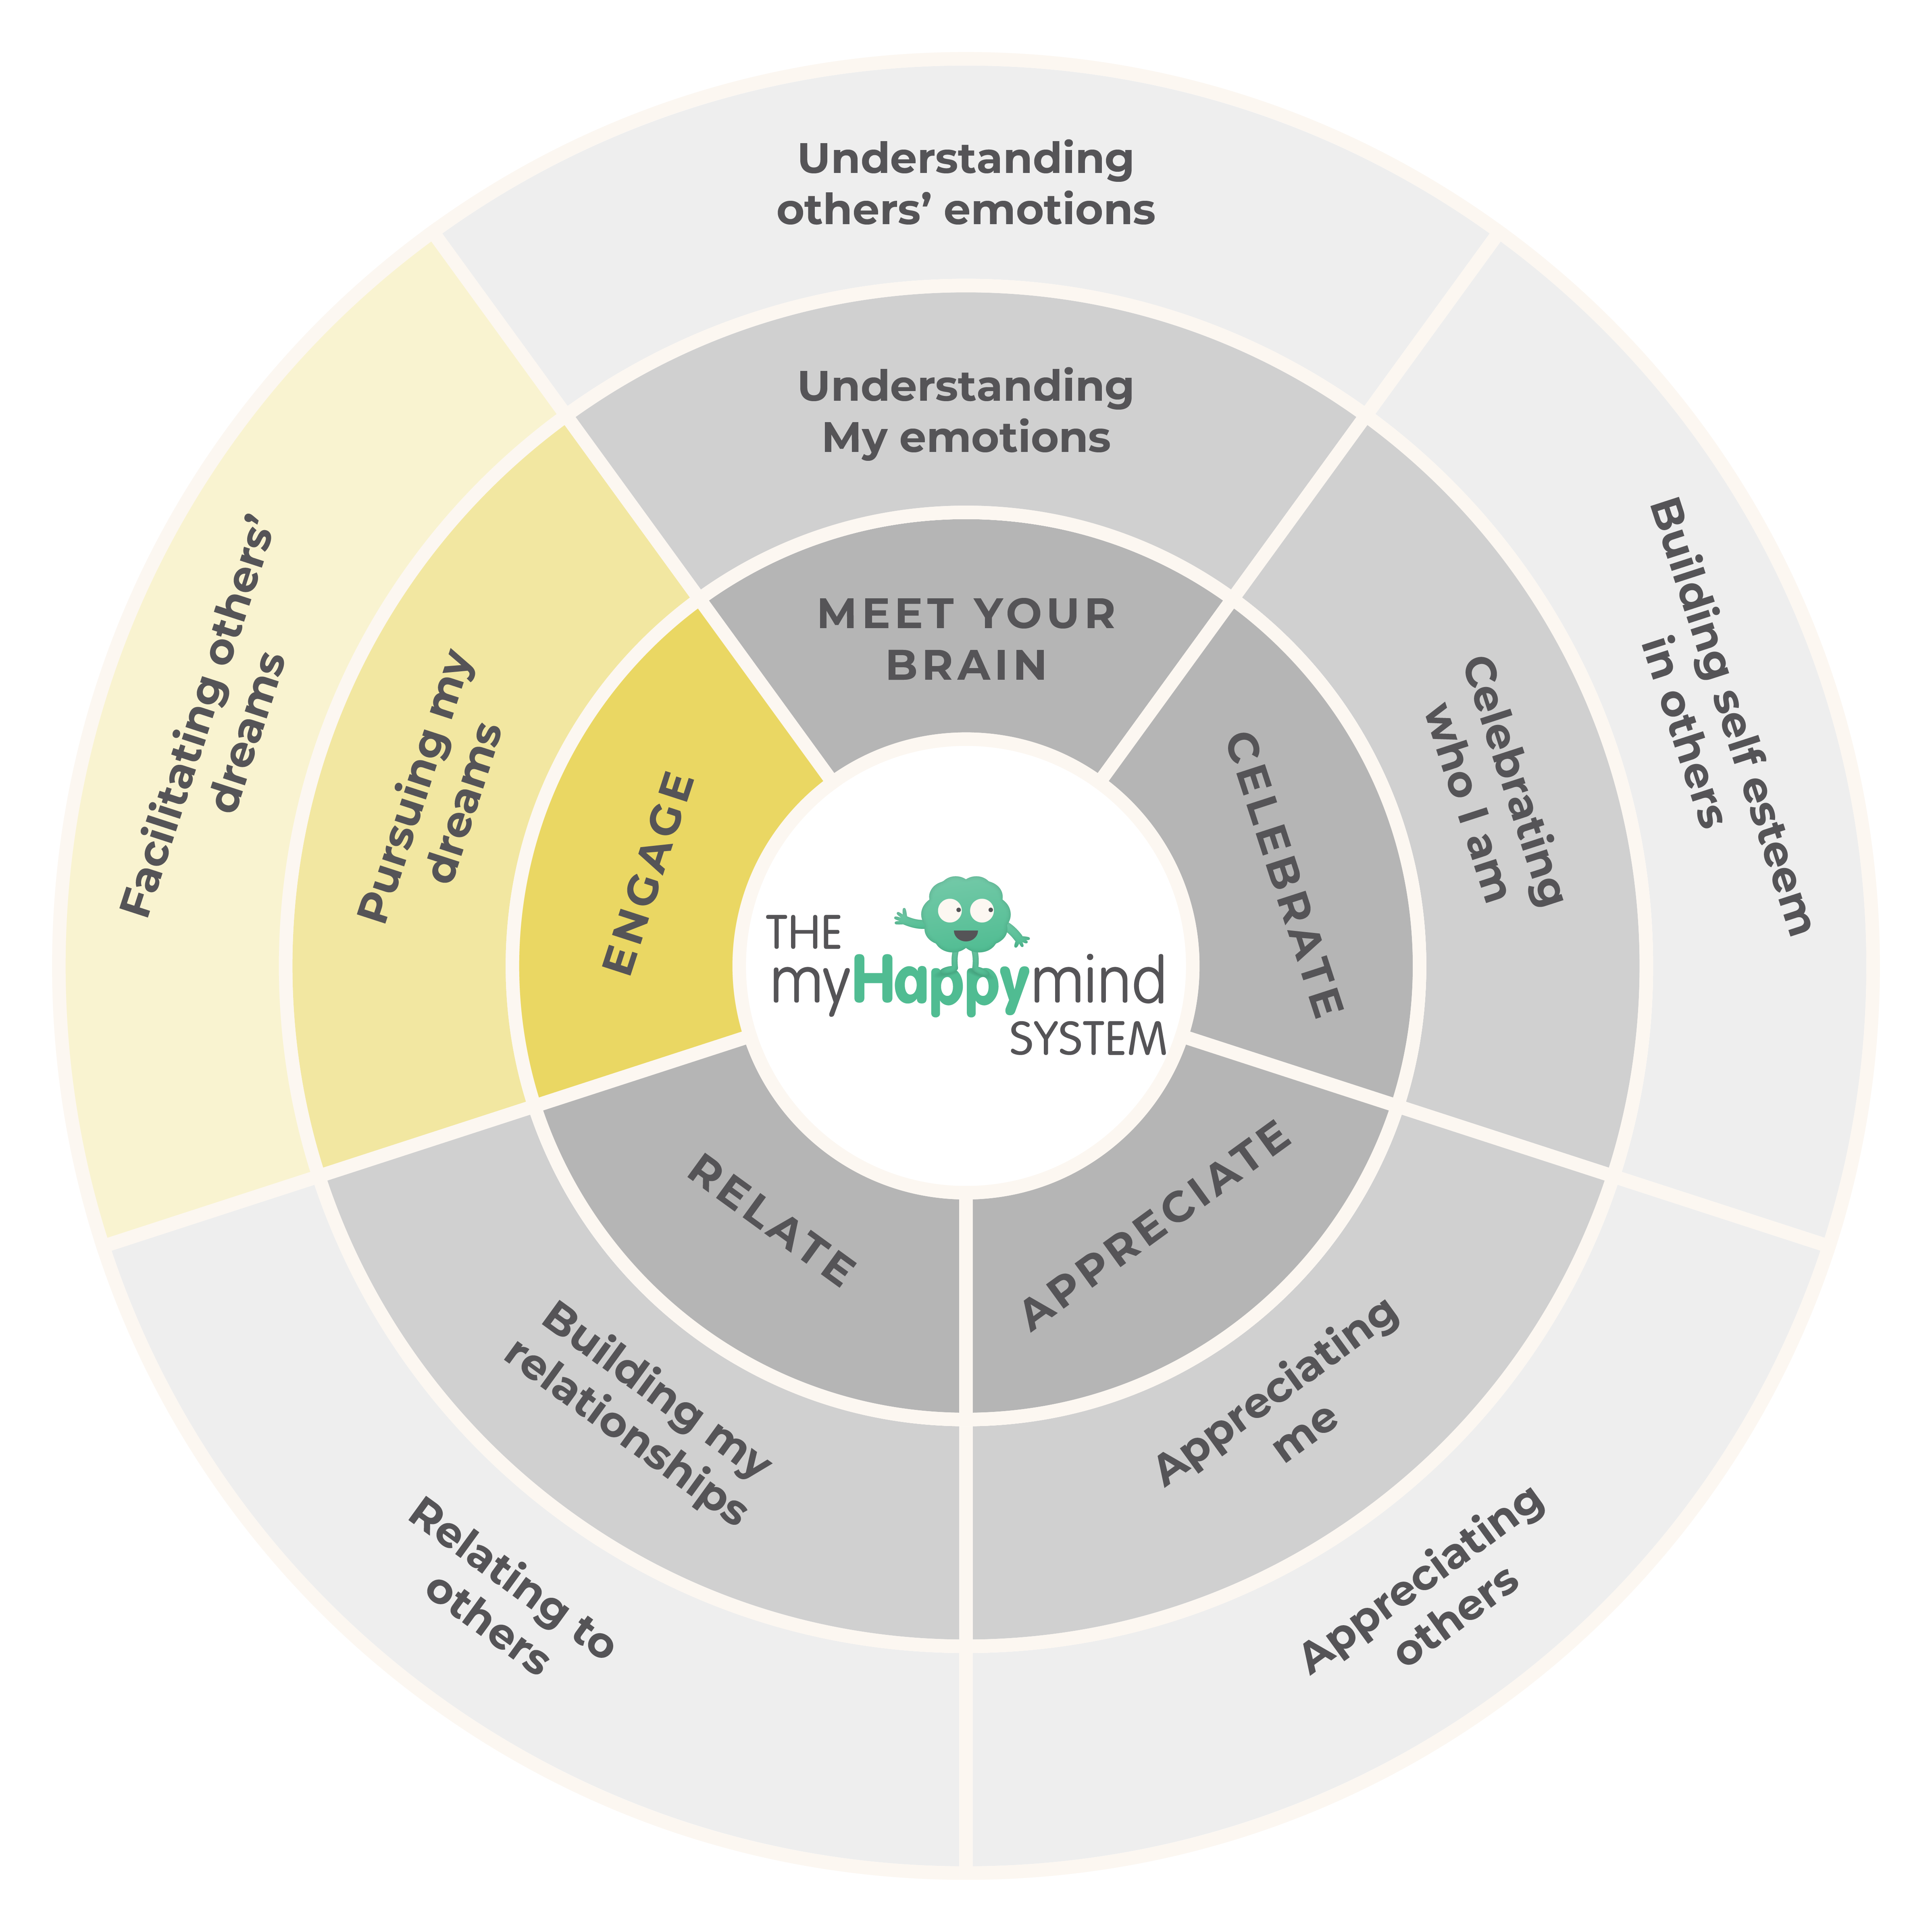
Engage –
Building resilience and perseverance
In this module we are focussed on building resilience and perseverance.
We do this by helping children to set their own ‘Big Dream Goals’; these are things that the children want to achieve because they are passionate about them e.g. learning a new skill in sport or art. By setting children up with goals they are internally motivated to achieve, we give them their own evidence that they already have the skills to be resilient and to persevere.
10

Slide 12

What teachers said before and after myHappymind
86%
of teachers said half or less of their children know how to set their own goals.
100%
of teachers have seen their children getting more excited about setting goals for themselves.
71%
of teachers said half or less of their children can Persevere in the face of challenge when trying to achieve goals.
100%
of teachers have seen an improvement in their children's resilience and perseverance when trying to achieve their goals.
100%
of teachers said that less than half of their children know how to make a plan to achieve their goals.
100%
of teachers have been able to use the 'goal setting' language through regular teaching.

Slide 13

Feedback
“Children have lots of fun thinking of Happy Breathing.”
“The children are able to tell anyone who will listen about neuroplasticity and the character strengths - it is really lovely to hear in children so young.”
“The children are showing more gratitude to each other.”
“It has helped the children to understand what active listening is.”
“I have seen my children get enjoyment out of achieving their goals and seeing an improvement in themselves and in their learning.”

Slide 14




Thanks for your time
Thank you for taking the time to
read this report. If you have any questions
or would like to discuss it, don't hesitate to get in touch.
Bridgeford House, Heyes Lane, Alderley Edge, SK9 7LA
hello@myHappymind.org
myHappymind.org
@myHappymind
@myHappymind_
@myHappymind

